Slide 1
Science Equipment
Label your Science Equipment Handout as we move through PowerPoint! Study for ID test!

Slide 2
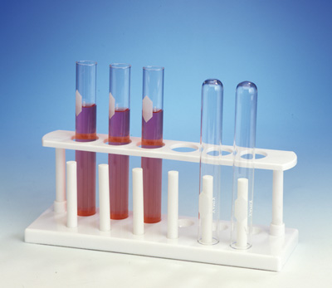
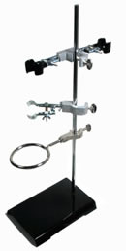
Test Tube
Test Tube Clamps

Slide 3
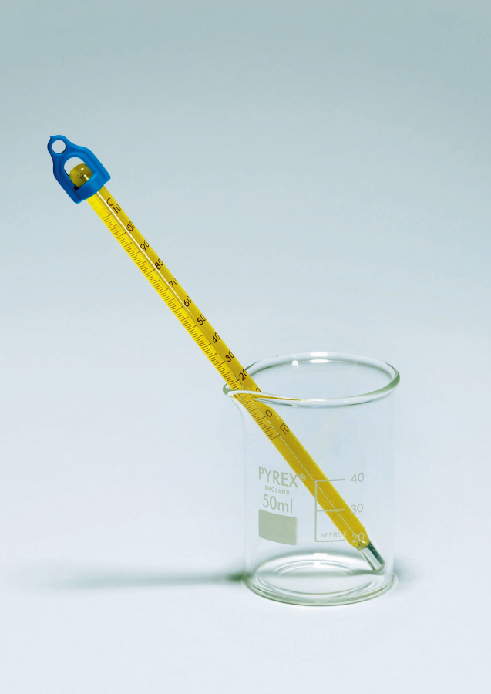
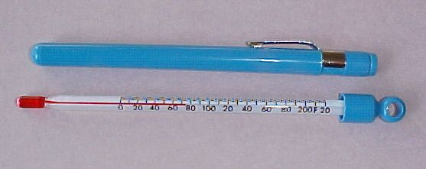
Thermometer

Slide 4
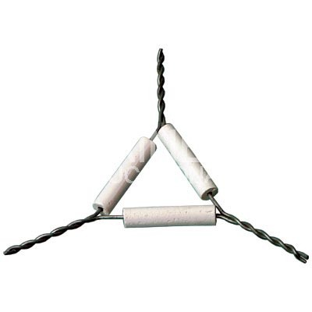
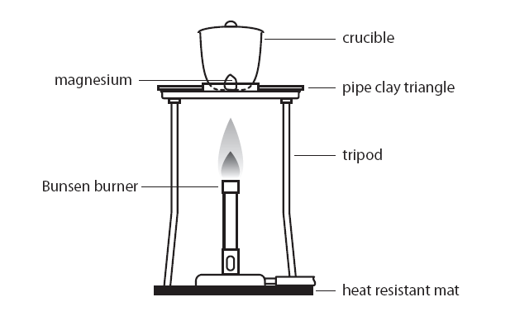
Triangle
Notes:
Magnesium is weighed and then heated in a crucible. It reacts with oxygen to produce the oxide. It can be shown that there has been an increase in mass. The results can be used to find the formula of magnesium oxide and two methods are described for doing so.

Slide 5
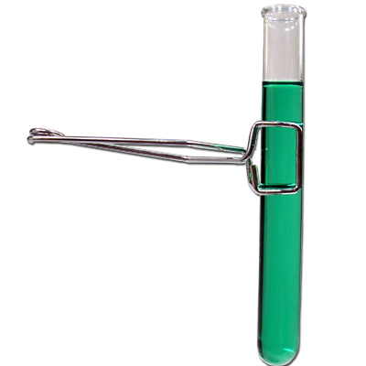
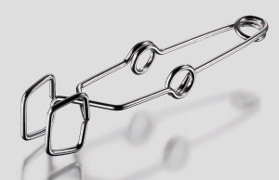
Test Tube Holder

Slide 6
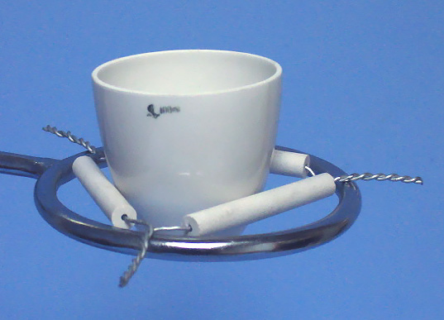
Crucible

Slide 7
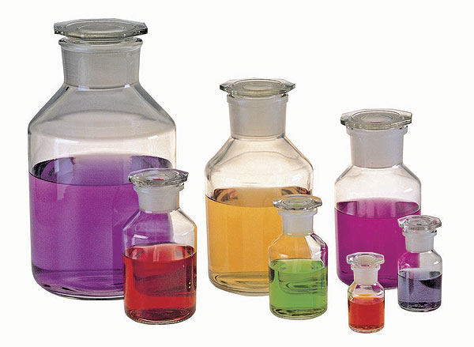
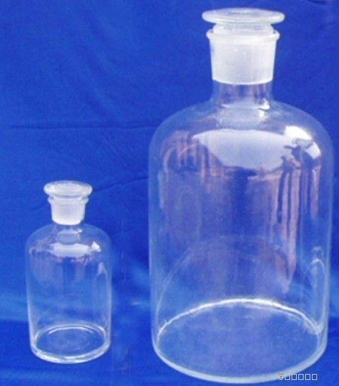
Reagent Bottle

Slide 8
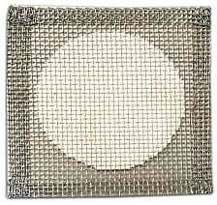
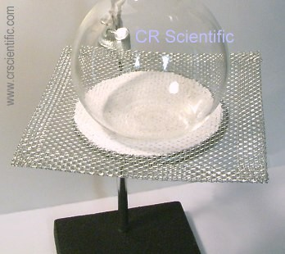
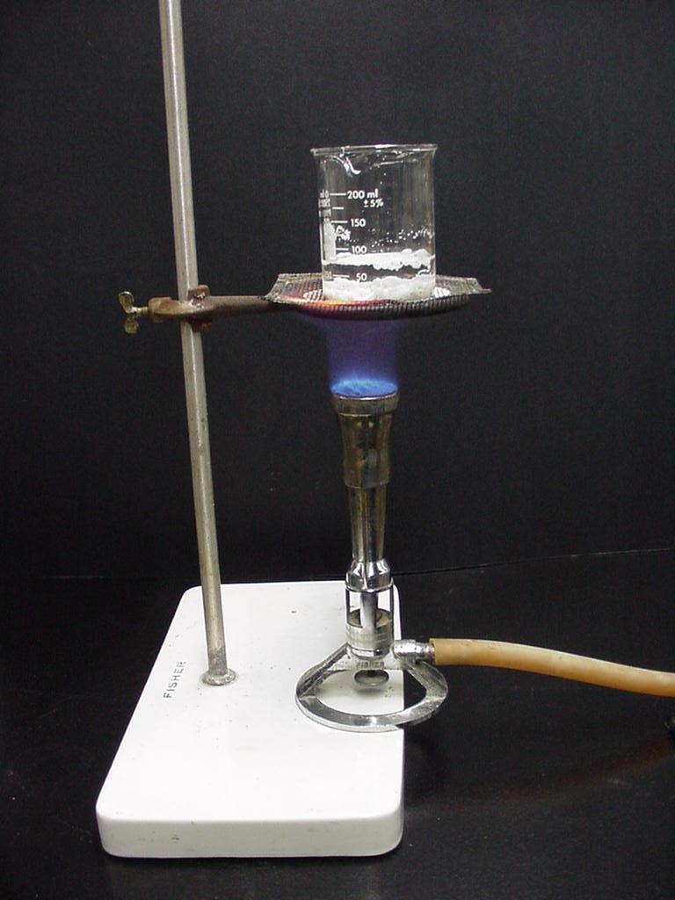
Wire Gauze

Slide 9
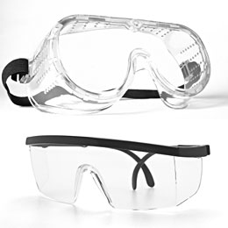
Safety Goggles/Glasses

Slide 10
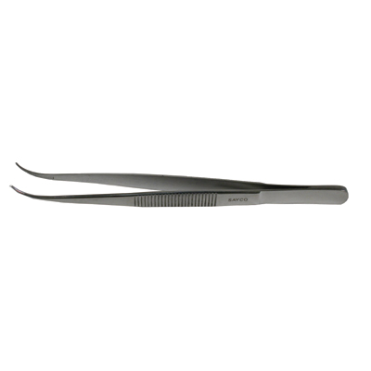
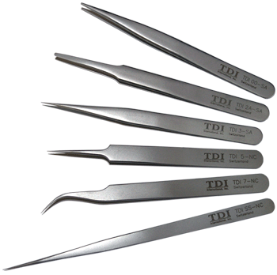
Tweezers/Forceps

Slide 11
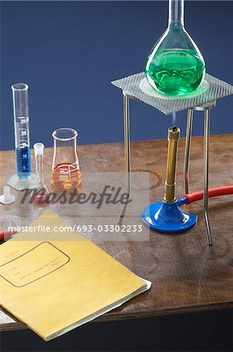
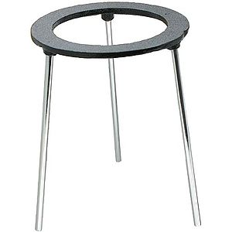
Tri-pod

Slide 12
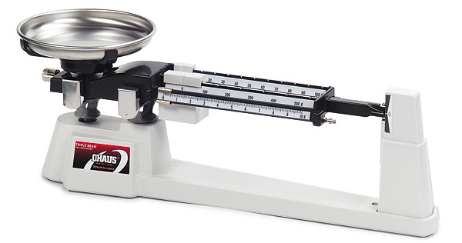
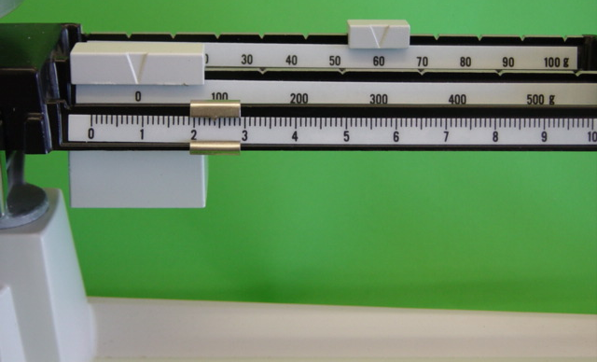
Triple Beam Balance

Slide 13
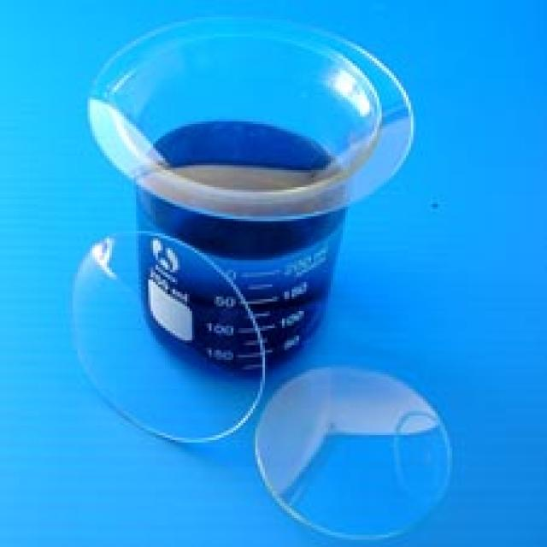
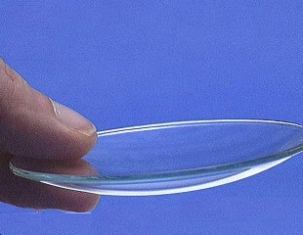
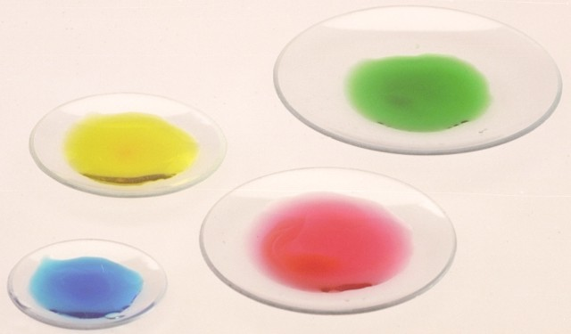
Watch Glass

Slide 14
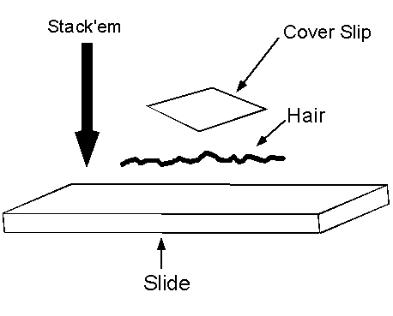
Cover slip

Slide 15
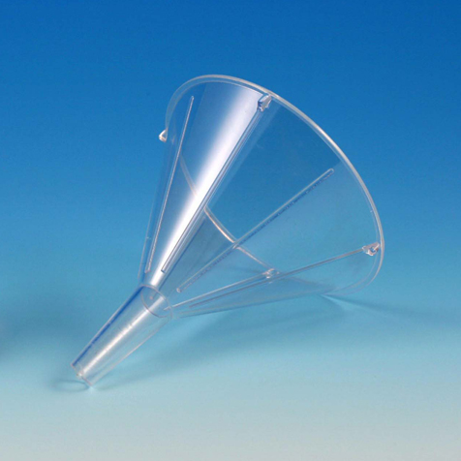
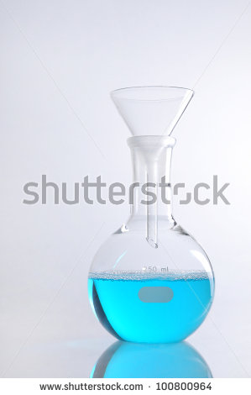
Funnel

Slide 16
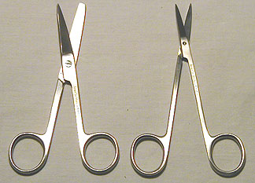
Dissecting Scissors

Slide 17
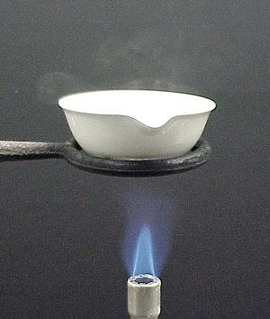
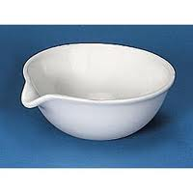
Evaporating dish

Slide 18
Test Tube Rack

Slide 19
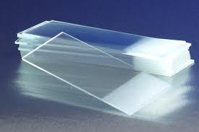
Microscope Slide
Concave

Slide 20
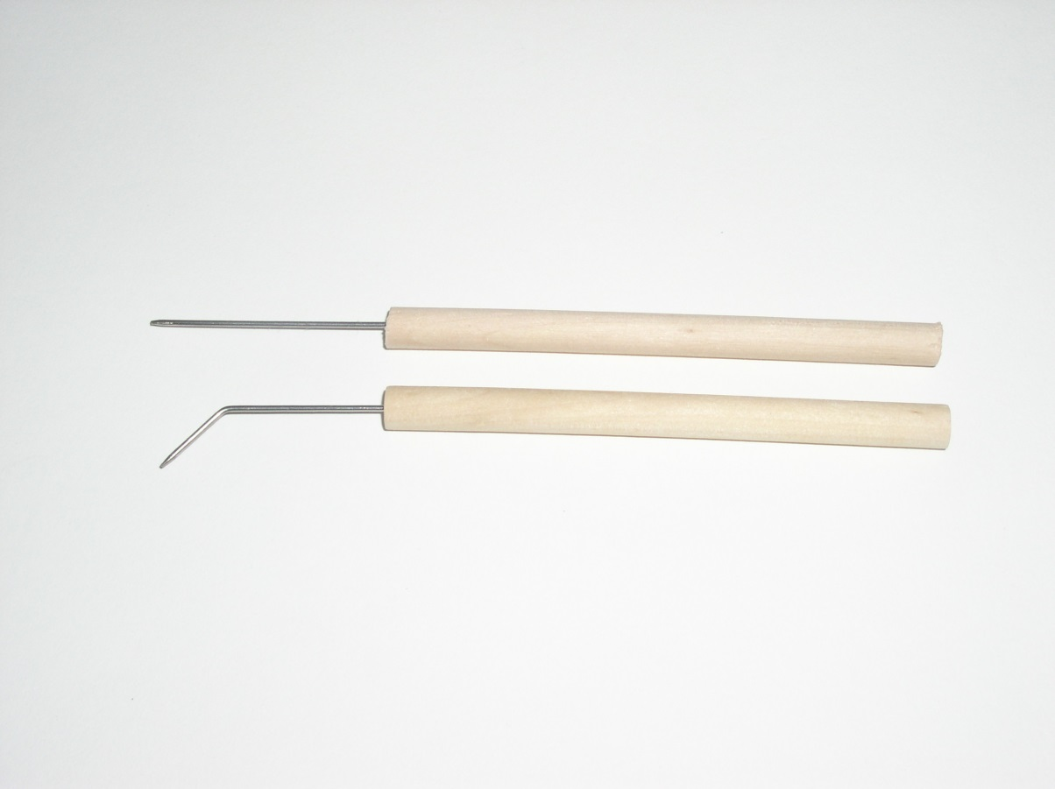
Teasing Needle/Probe

Slide 21
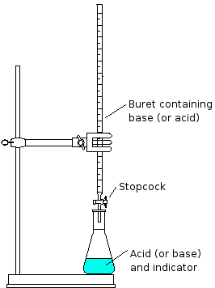
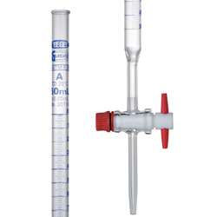
Buret

Slide 22
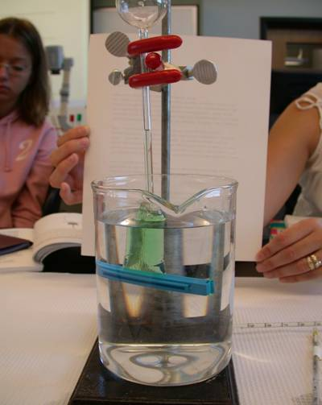
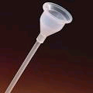
Thistle Tube Funnel
Osmosis Lab
Notes:
http://www.nku.edu/~dempseyd/lab%20on%20membrane%20transport_files/v3_document.htm

Slide 23
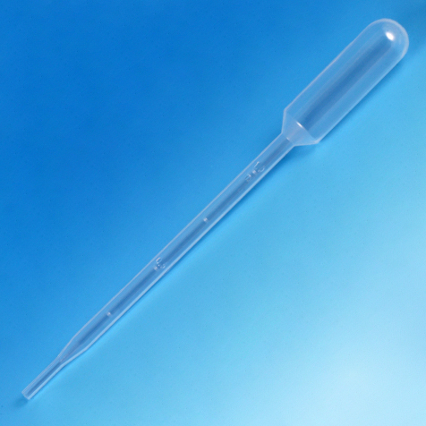
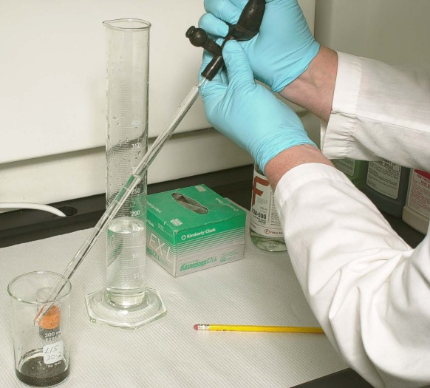
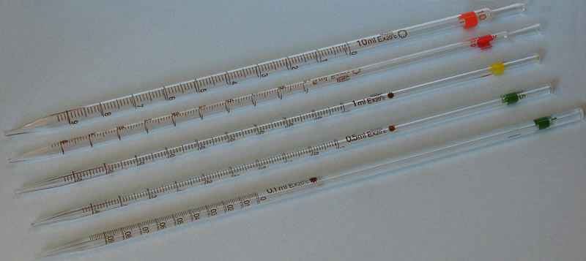
Pipette

Slide 24
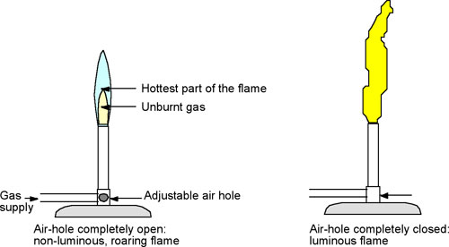
Bunsen Burner

Slide 25
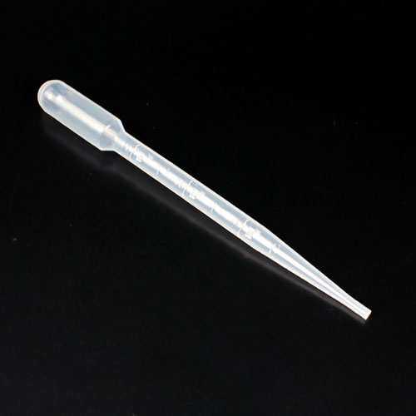
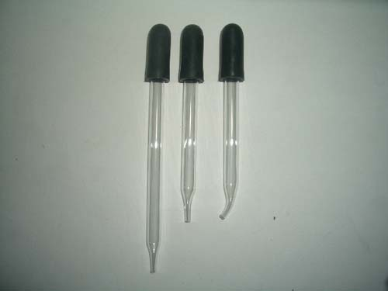
Dropper

Slide 26
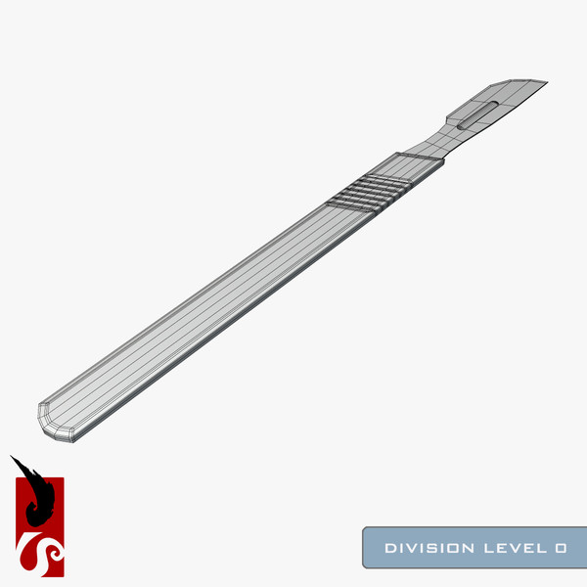
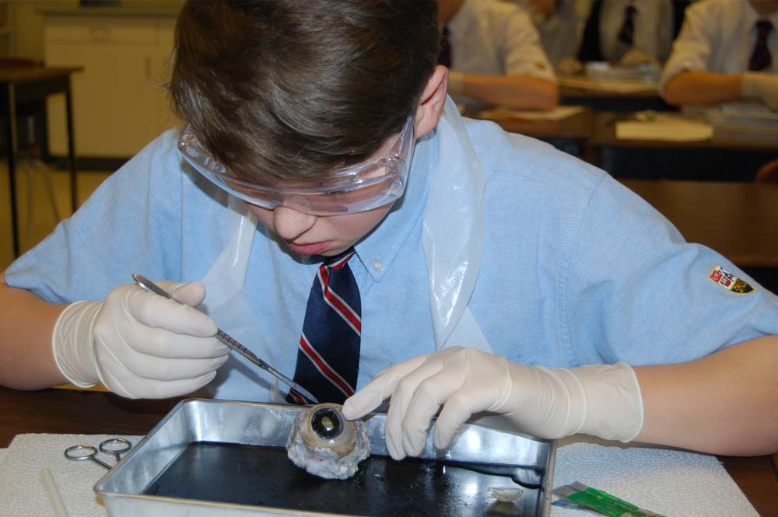
Scalpel

Slide 27
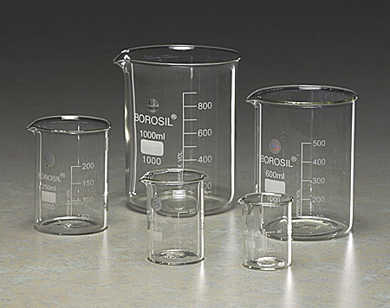
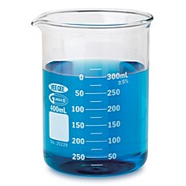
Beaker

Slide 28
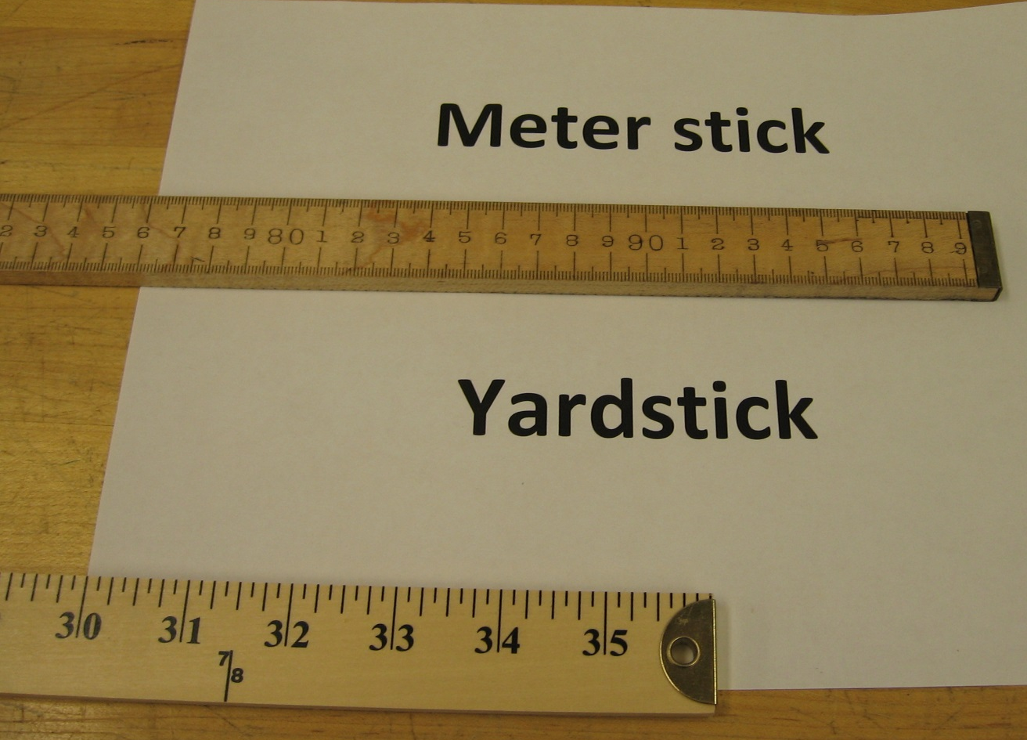
Meter Stick

Slide 29
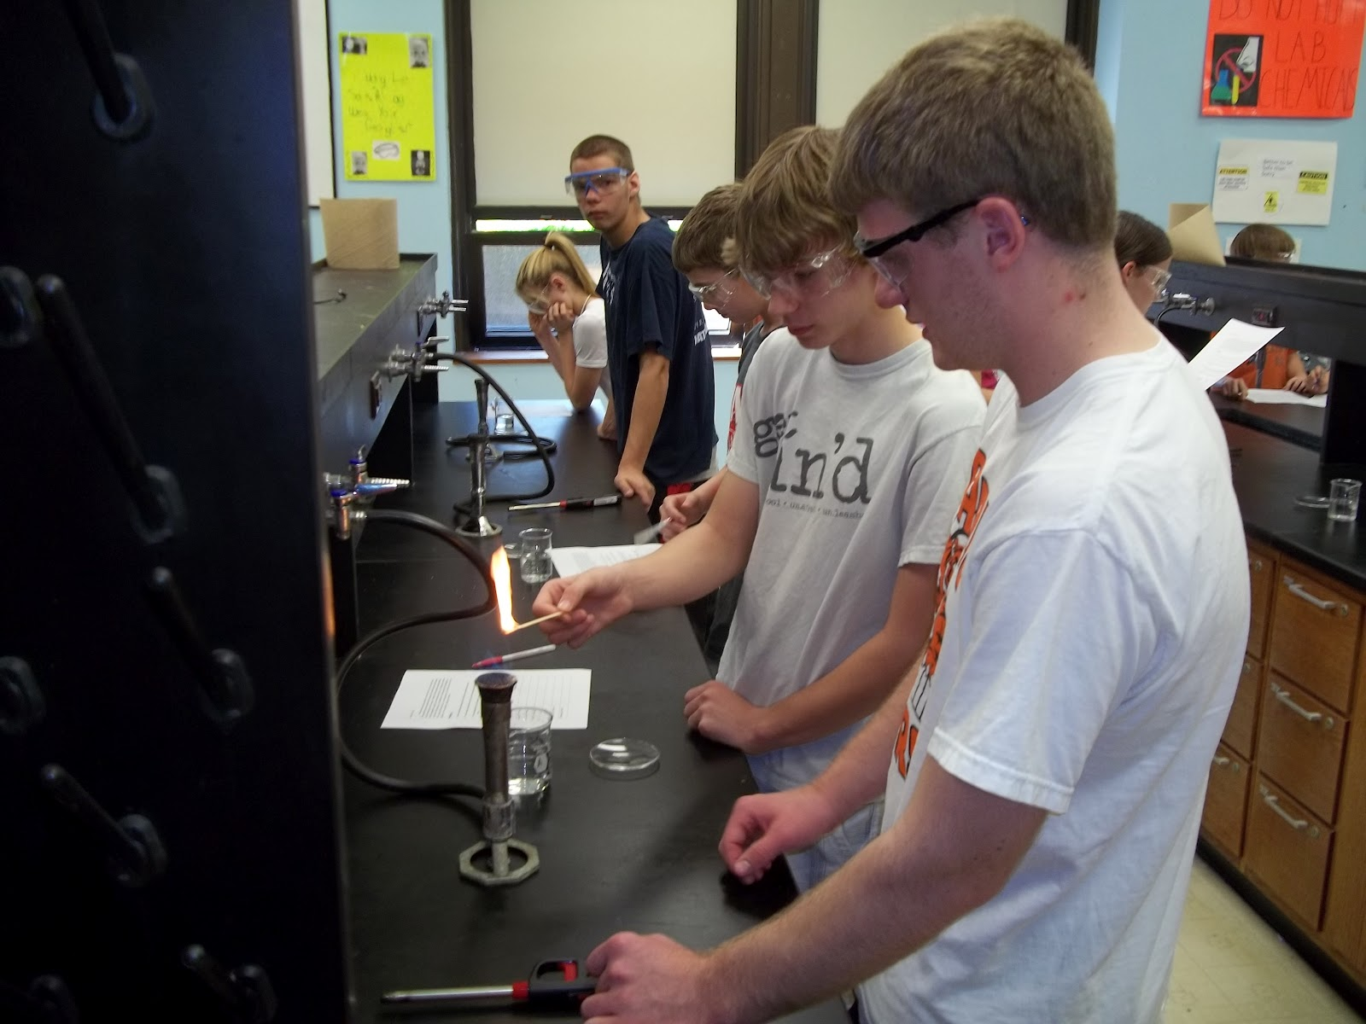
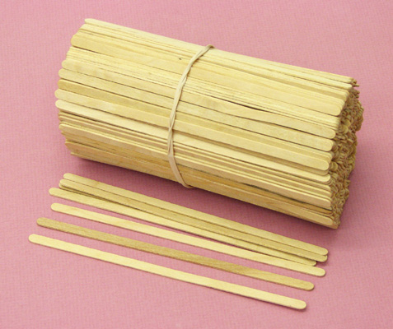
Wooden Splint

Slide 30
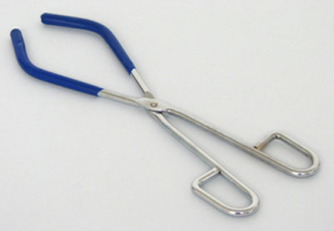
Beaker Tongs

Slide 31
Test Tube Brush Cleaner

Slide 32
Crucible Tongs

Slide 33
Petri-dish
One might ask why agar, as opposed to regular gelatin (like that found in Jello), is used for culturing bacteria. The answer is agar, unlike gelatin, won't be degraded (eaten) by bacteria. Also, agar is firmer and stronger than gelatin. It's still possible, however, to use gelatin as a culture medium for bacteria if agar is unavailable.(2)
Notes:
A Petri dish contains a colony of bacteria. Every minute every bacterium divides into two. The colony was started by just one cell at noon. 47 minutes later the Petri dish was half full. At what time will the dish be full of bacteria?
http://www.sks-science.com/sciencefair/ScienceLab4.html agar lab

Slide 34
Erlenmeyer flask
Florence Flask

Slide 35
Graduated Cylinders

Slide 36
Mortar-Pestle

Slide 37
Ring stand

Slide 38
Florence Flask

Slide 39
Compound Microscope
Dissecting Micoscope

