Slide 1
Public Land Survey Part one Township, Range and Legal Land Description

Slide 2
History of the Township and Range System
The Land Ordinance of 1785 devised a system of base lines and meridian lines to survey the western lands outside of the initial 13 colonies.
Notes:
This Ordinance is one of many that were created for describing property. See History of Public Land Survey System.

Slide 3
Terms used in the Township and Range System:
Section
Basic unit of the system, a square tract of line one mile by one mile containing 640 acres.
Township
36 sections arranged in a 6 by 6 array, measuring 6 miles by 6 miles. Sections are numbered beginning with the northeast-most section, proceeding west to 6, then south along the west edge of the township and to the east.
Range
Assigned to a township by measuring east or west of a Principal Meridian
Range Lines
North to south lines which mark township boundaries
Township Lines
East to west lines which mark township boundaries
Principal Meridian
Reference or beginning point for measuring east or west ranges.
Base line
Reference or beginning point for measuring north or south townships.
Notes:
Basic vocabulary for powerpoint

Slide 4
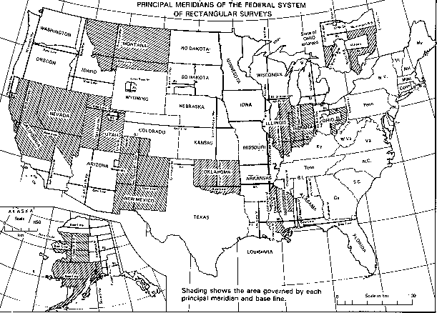
Notes:
http://www.rootsweb.ancestry.com/~alfrankl/landrecords.htm ZOOM IN
Maps shows the original 13 colonies that use Meets and Bounds and them all the different Principal Meridian Systems West of the original 13 colonies. There are 37 across the rest of the country.

Slide 5
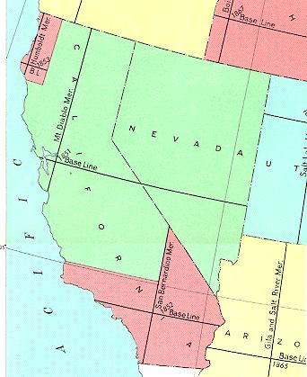
California has three Principle Meridians
Humbolt
Principal
Meridian
Mt. Diablo
Principal
Meridian
San Bernardino
Principal
Meridian
Notes:
California has 3 separate Principal Meridian Systems.

Slide 6
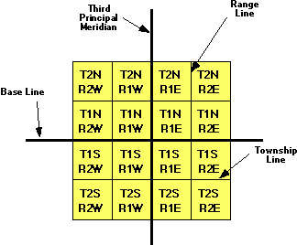
Graphical Display of the Federal Township and Range System
Notes:
Off of each Meridian and Base Line the land is boxed with township lines measuring north and south and Range lines measuring east and west

Slide 7
What is the township and range information which is missing?
Mt. Diablo
Notes:
Have student draw and fill in empty boxes.

Slide 8
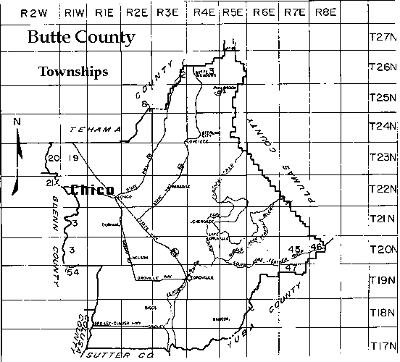
Notes:
Shows the range lines across top and township lines down the side. Try to find a picture of your town with the township range overlay. See links to get one of your area.

Slide 9
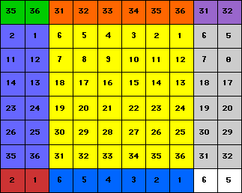
On a map, the townships may be distinguished apart by observing the section numbers. Here, there is one full township and portions of eight other townships.
T2N
R1W
T2N
R1E
T2N
R2E
T1N
R1E
T1N
R1W
T1N
R2E
Mt.
Diablo
T1S
R1W
T1S
R1E
T1S
R2E
Notes:
Each township is broken into 36 sections starting in the northeast corner and flowing west, snaking around to the southeast corner.

Slide 10
Each Township has 36 Sections (1 square-mile each)
6 | 5 | Section 4 | Section Number 3 | Section Number 2 | Section Number 1
7 | 8 | 9 | 10 | 11 | 12
18 | 17 | 16 | 15 | 14 | 13
19 | 20 | 21 | 22 | 23 | 24
30 | 29 | 28 | 27 | 26 | 25
31 | 32 | 33 | 34 | 35 | 36
6 miles

Slide 11
What sections have been left unnumbered?
One Township
 | 5 | 4 | 3 |  | 1
7 | 8 |  | 10 | 11 | 12
18 | 17 | 16 |  | 14 | 13
 | 20 | 21 | 22
 | 29 |  | 27 | 26 | 25
Notes:
Have students fill in empty numbers.

Slide 12
Questions
What lines measure north and south?
What lines measure east and west?
How are sections ordered in a township?
What are the three principal meridians in California?
Notes:
Townships
Range Lines
Snaking
Humboldt, Mt. Diablo, San Bernadino

